Slide 2
Central dogma
Replication
Transcription
Translation
Splicing

Slide 3
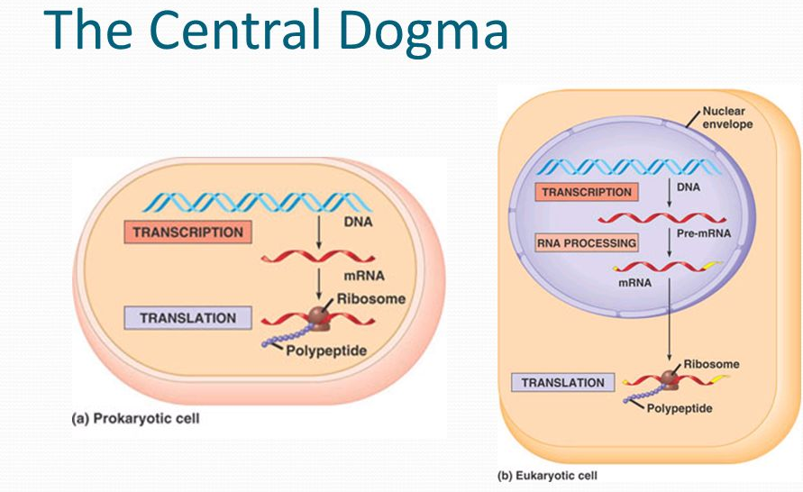
Basic cellular mechanisms of life
DNA
Replication
Decoding of the genetic code
RNA
Transcription
Proteins
Translation

Slide 4
Activity 1
Calculate the total number of cells in a 50 kg person
This is an approximate calculation for illustration purpose
Cell dimension is 10 um in diameter for a sphere
Assumptions
Assume the cell to be cubical in shape[although spherical is more appropriate]
For conversion use 1dm³ = 1 l = 1 kg.

Slide 5
Activity 1
Q: How many cells are there approximately in an average 50 kg person?
10 microns diameter of a cell
Volume = 10 x 10 x 10 um³ = 1 cell [assuming it to be a cube]
So in 1 mm³, there will be about 1 million cells [1 um is 10⁻³mm or 1mm = 10³ mm].
In a dm³ , there will be 10¹² cells – 1 trillion
1 dm³ = 1l = 1kg [assumption]
About 50 trillion cells.
Notes:
5-10min
5

Slide 6
Activity 2
Calculate the length of the DNA
Human DNA- 6.6 * 10⁹ bp
Each base pair – 0.34 nm
Notes:
10min
6

Slide 7
Activity 2
Calculate the length of the DNA
Human DNA- 6.6 * 10⁹ bp
Each base pair – 0.34 nm
About 2m long
Amount of pressure and the level of packaging
Compare the size to that of the cell average is 6um in diameter!!!
Notes:
10min
7

Slide 8
DNA is just a fine, spiral coiled thread in the nucleus of every living cell.
The human genome, encoded as DNA, contains 23 chromosome pairs, which is like 500 thousand to 2.5 million nucleotide pairs.
What if it were to be stretched or coiled? Every human being has about ten trillion cells in their body. If all DNA cells are stretched, they can go as far as 744 million miles. Now the moon is only about 2,50,000 and the Sun is 93,000,000 miles away.

Slide 9
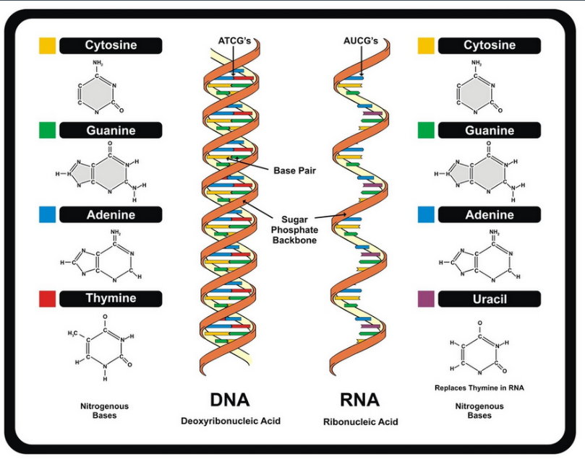
Structure of DNA/ RNA
Double helix
Consists of 4 base pairs
Sugar- Phosphate backbone
Colored blocks are the bases.
There are 2 strands of the backbone that runs in opposite direction
The bases on the 2 strands base pair

Slide 10
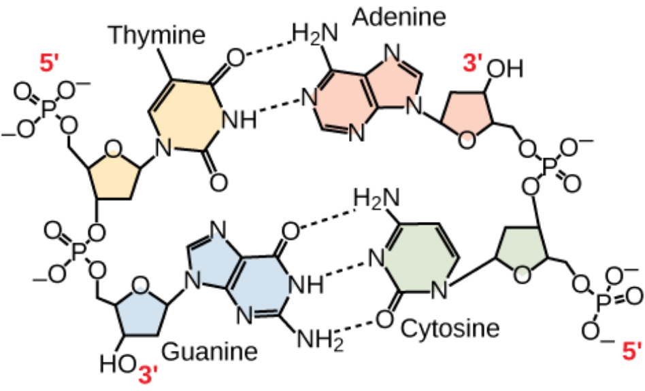
The rules pertaining to the basic DNA structure
There are 4 bases- Adenine [A], Guanine[G], Thymine [T], Cytosine [C].
A pairs with T [2 H-bonds]
G pairs with C [3 H-bonds]
Note!!!
The 2 strands are anti-parallel to each other.
Observe the sugar-Phosphate backbone to understand
------
Other terminologies- Complementary strands

Slide 11
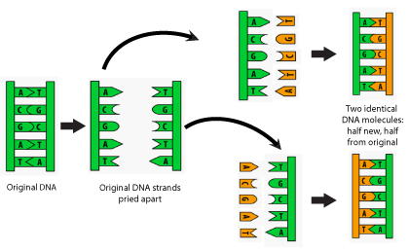
Replication- Making copies of DNA
Simple steps
Helicases- Unwinds DNA
Polymerases- Creates Complementary strand

Slide 12
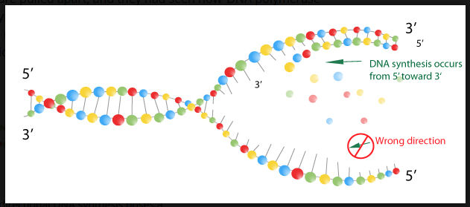
Replication – More details pertaining to directionality

Slide 13
DNA to mRNA
5’ TAC GCT GCT AGC TAG TCA 3’
3’ 5’ ??
3’ ATG CGA CGA TCG ATC AGT 5’
5’ UAC GCU GCU AGC UAG UCA 3’
5’ TAC GCT GCT AGC TAG TCA 3’
3’ ATG CGA CGA TCG ATC AGT 5’

Slide 14
Activity
5’TGG CCA TGC GCA AGC TGG TGC GCT CAG 3’
3’ TGG CCA TGC GCA ACC TGG TGC GCT CAG 5’

Slide 15
Activity

Slide 16
Speed and Precision of DNA replication
Polymerase 700 bp per sec
Errors 1 in 10^7 nucleotides
With proof-reading 1 in 10^9 nucleotides
ATCTCTCTAGCTAGCTAGCTAGCTAGCTAGCTAGCTAGCTAGCAT

Slide 17
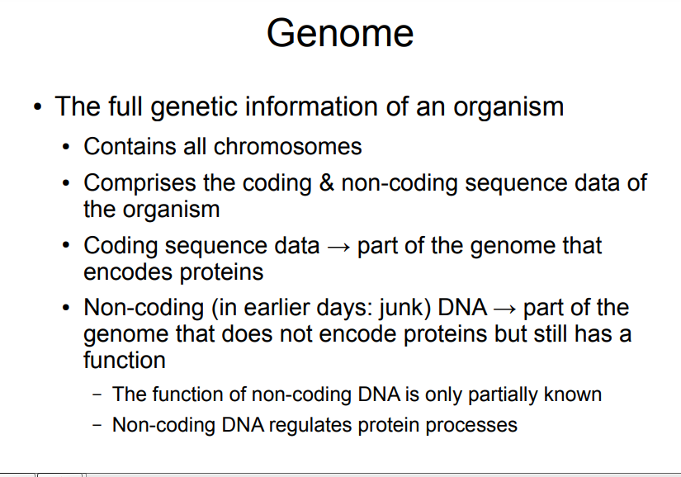

Slide 18
Difference between individuals
Roughly only 0.1% of the 3 billion nucleotide human genome (or 3 million bases) are different
Still, this leaves room for roughly 4 3,000,000 different genomes, and is for all intents and purposes an endless diversity.between any two individuals.
While specific individuals of the species may differ in some bases, the basic long DNA sequence is roughly the same in all members of the species. Of course, this handful of differences is critically important, and the large Human Diversity Project is underway to understand how various individuals differ. This will hopefully identify the mutations reponsible for a number of genetic diseases

Slide 19
Difference between species
The human genome - about 3 billion bases
The fly genome has a scant 140 million bases.
However, an analysis of the genomic sequences for two vastly different organisms (fruit flies and humans) has revealed that many genes in humans and flies are similar.
As many as 99% of all human genes are conserved across all mammals!
Some human genes show strong similarity across not only mammals and flies but also across worms, plants, and (worse yet) deadly bacteria. A species, then, is a collection of individuals whose genomes are “compatible,” in the sense of mating.

Slide 20
Evolution and Natural selection
Some process must exist that generates new species from old ones. This process is called evolution.
The theory that all living things have evolved through a process of incremental change over millions of years has been at the heart of biology since the publication in 1859 of Charles Darwin’s On the Origin of Species.
Filtering of mutations is called natural selection

Slide 21
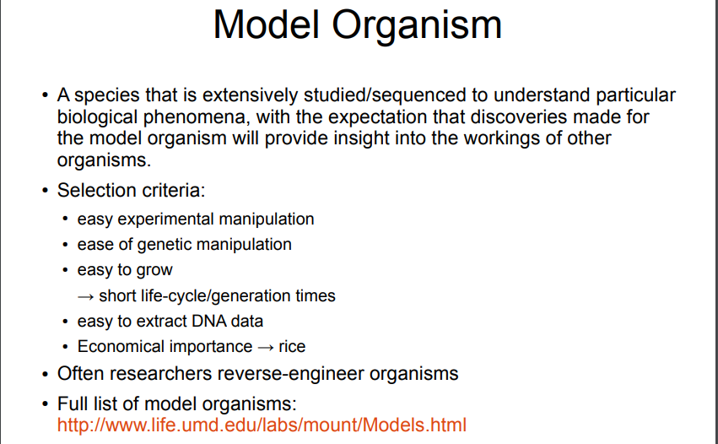

Slide 22
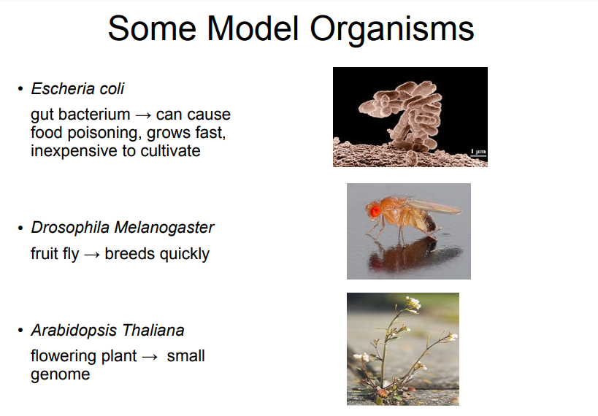

Slide 23
Types of mutations
Substitution- Exchanges one base for another
Insertion- Insertion of extra base pairs
Deletion- Deletion of a base pair or sections of DNA
Frame shift- Insertions or deletions resulting in altered proteins due to a shift in the frames.
There are other types but the above ones are the basic.

Slide 24
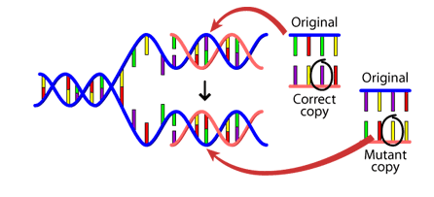

Causes of mutation
DNA fails to copy accurately
External influences can create mutations- harmful chemicals and radiation
Cell can repair- But is not perfect

Slide 25
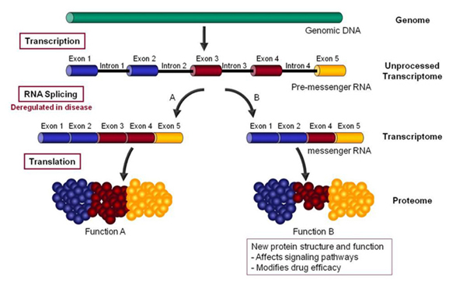
Hutchinson-Gilford Progeria Syndrome – a disease of accelerated aging due to Alternative Splicing
http://www.anti-agingfirewalls.com/2016/02/04/hutchinson-gilford-progeria-syndrome-a-disease-of-accelerated-aging-due-to-alternative-splicing/

Slide 26
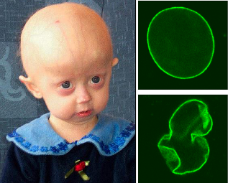
“HGPS is a major clue to solving the “puzzle of aging” and the molecular mechanisms here are relevant to normal aging. ”
https://en.wikipedia.org/wiki/Progeria

